Slide 1
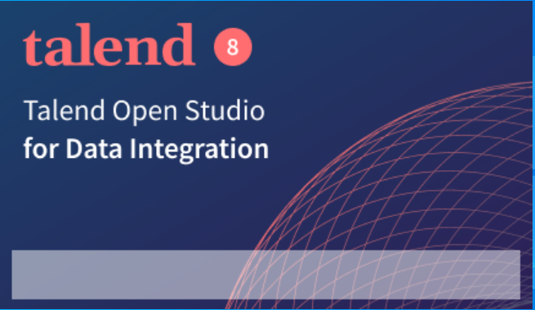
Talend
Team: Dr.B.R Ambedkar

Slide 2
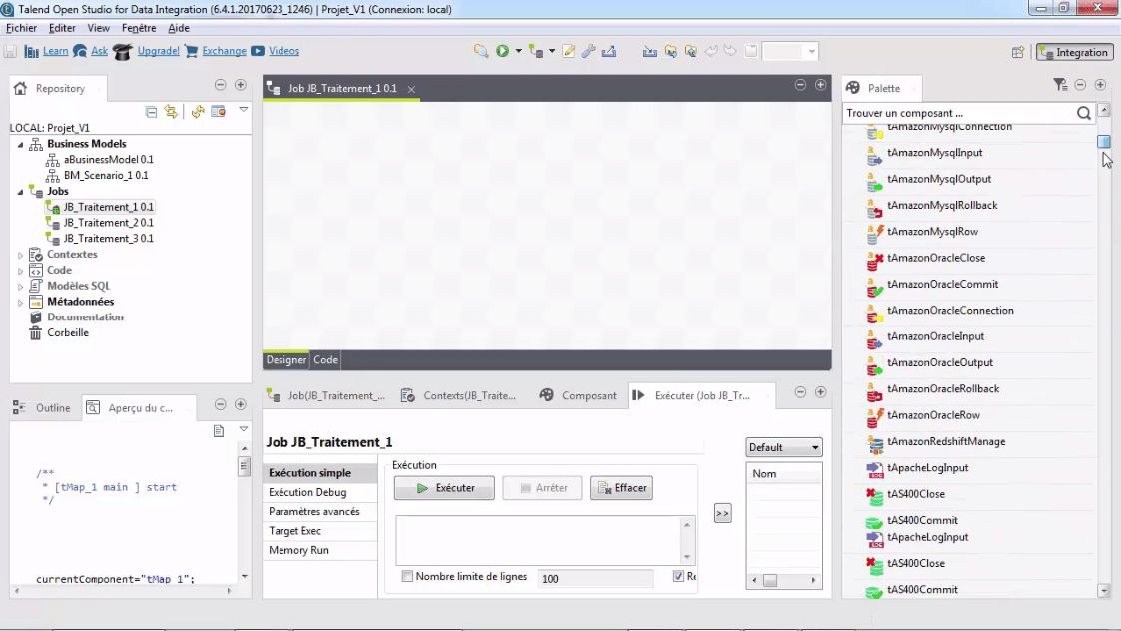

Slide 3
The Talend is an open-source software integration platform that allows various solutions like data integration, data management solutions, big data, data quality, and data preparation.
It is divided into three main features:
Repository:
The Repository is the collection of technical components used in a job.
In this section metadata of databases, table schemas and structure can be created and stored.
Design Workspace:
Jobs can be designed and modeled with the help of a designer tab that shows the work graphically, and the code tab to detects possible errors and read the generated code.
Component Palette:
Contains the various components required to build a job. It can also reduce the amount of hand-coding needed to work on multiple data.

Slide 4
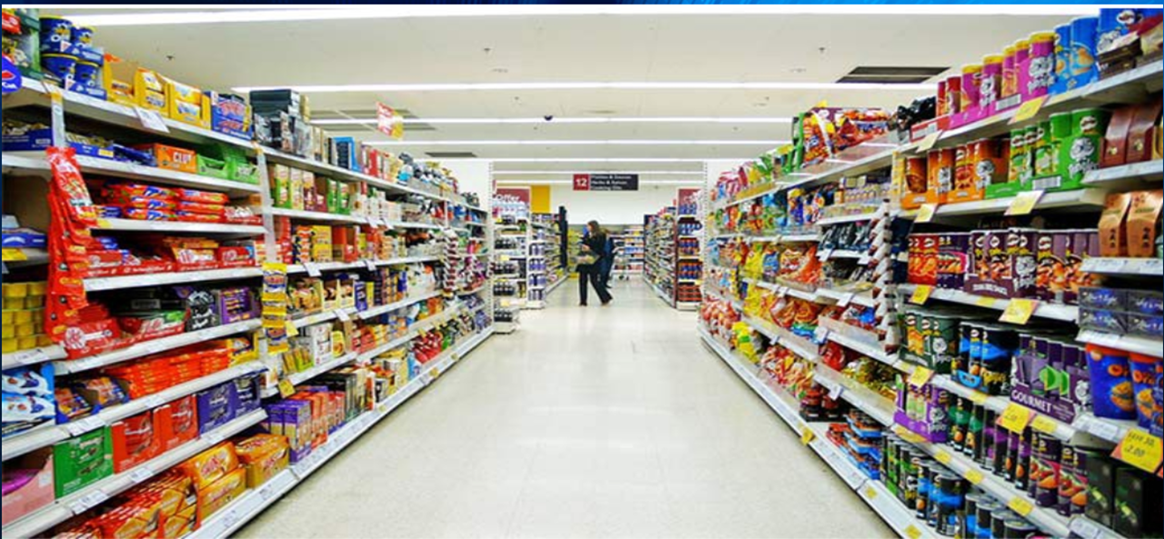
Supermarket Sales in Myanmar:

Slide 5
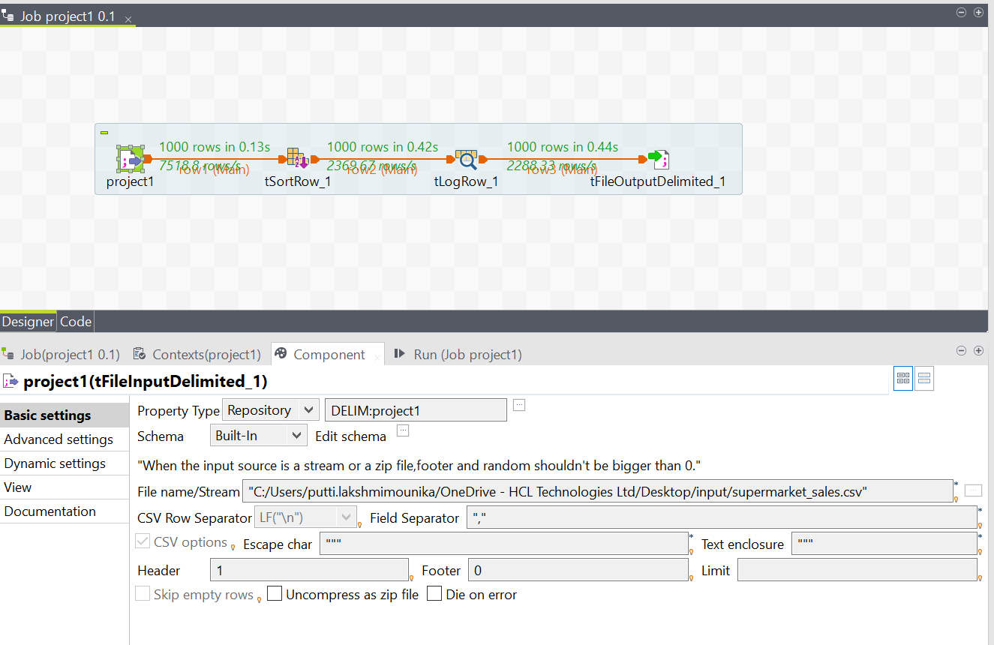
tfileinputdelimited (project1) component and its specifications

Slide 6
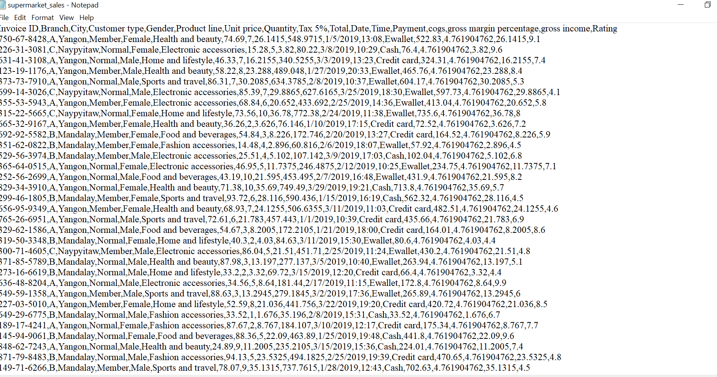
Input file consists data with which we work in tfileinputdelimited(project1) component
It is saved in .csv format

Slide 7
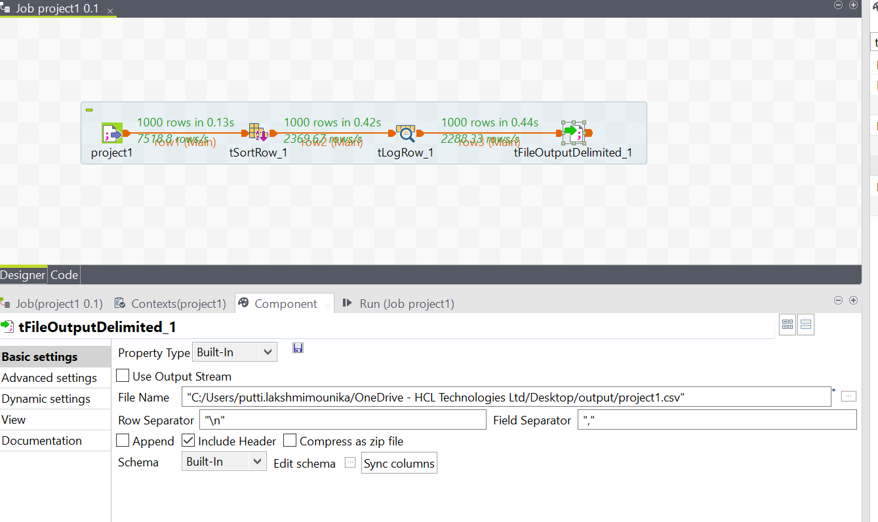
tfileoutputdelimited component and its specifications

Slide 8
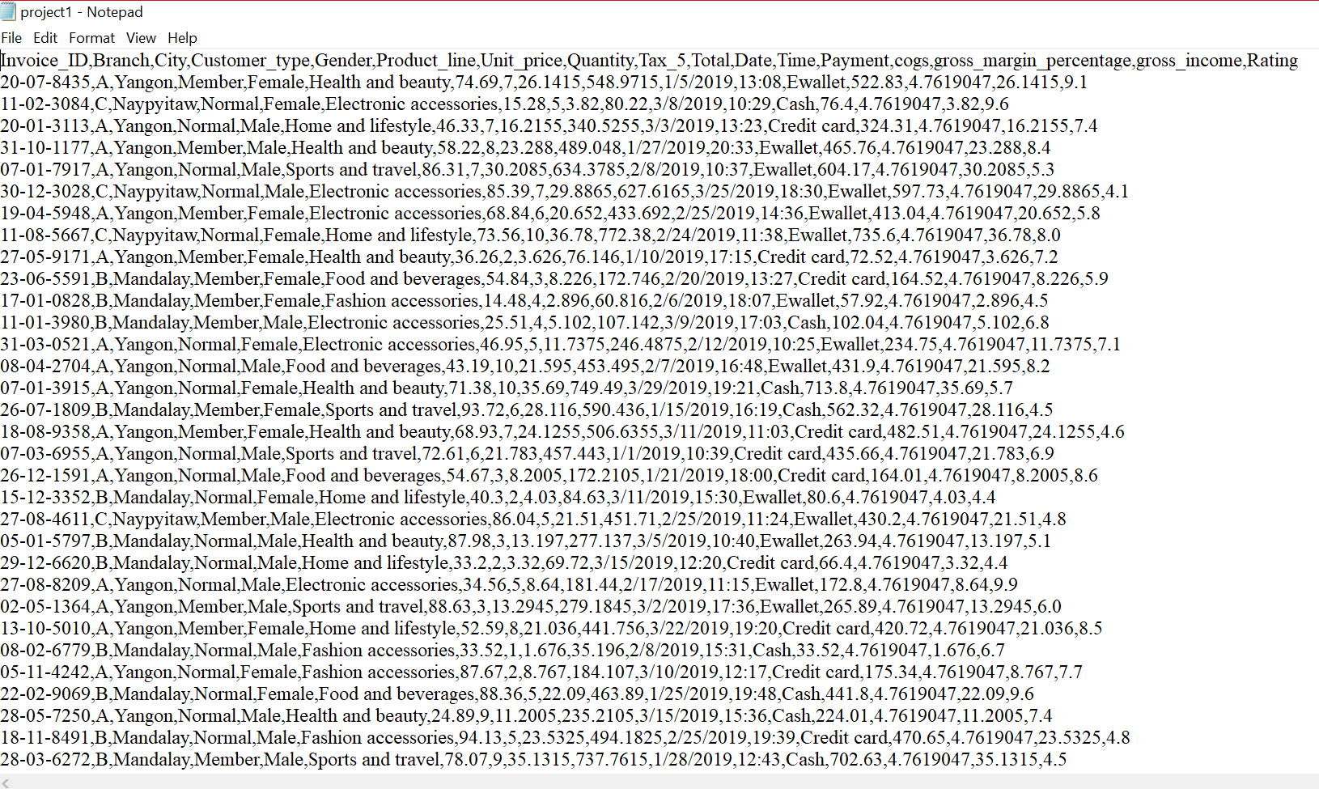
The output file attached to tfileoutputdelimited _1 is also saved in .csv format which gets data after running the job.

Slide 9
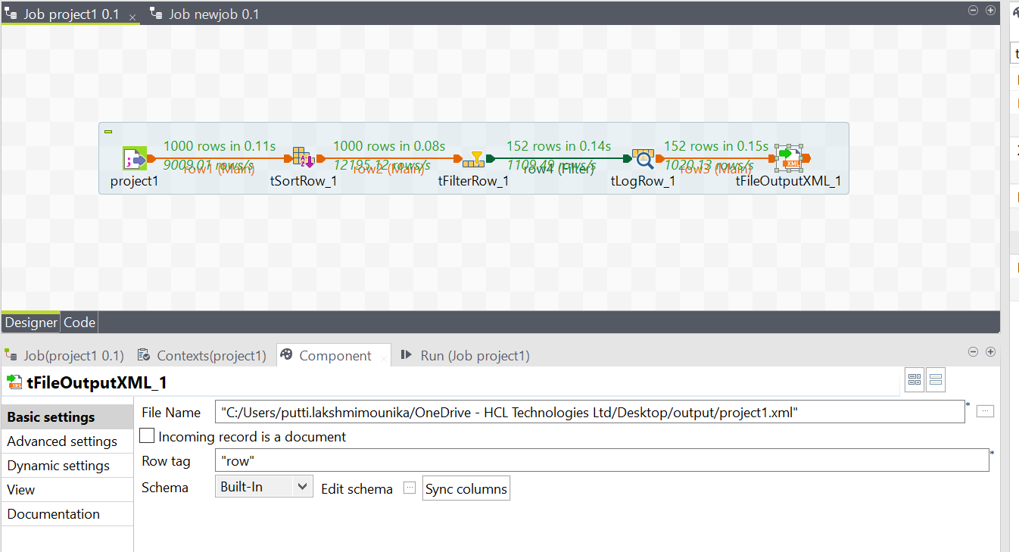
tFileoutput.Xml is an Xml format file which gives data in the xml format.

Slide 10
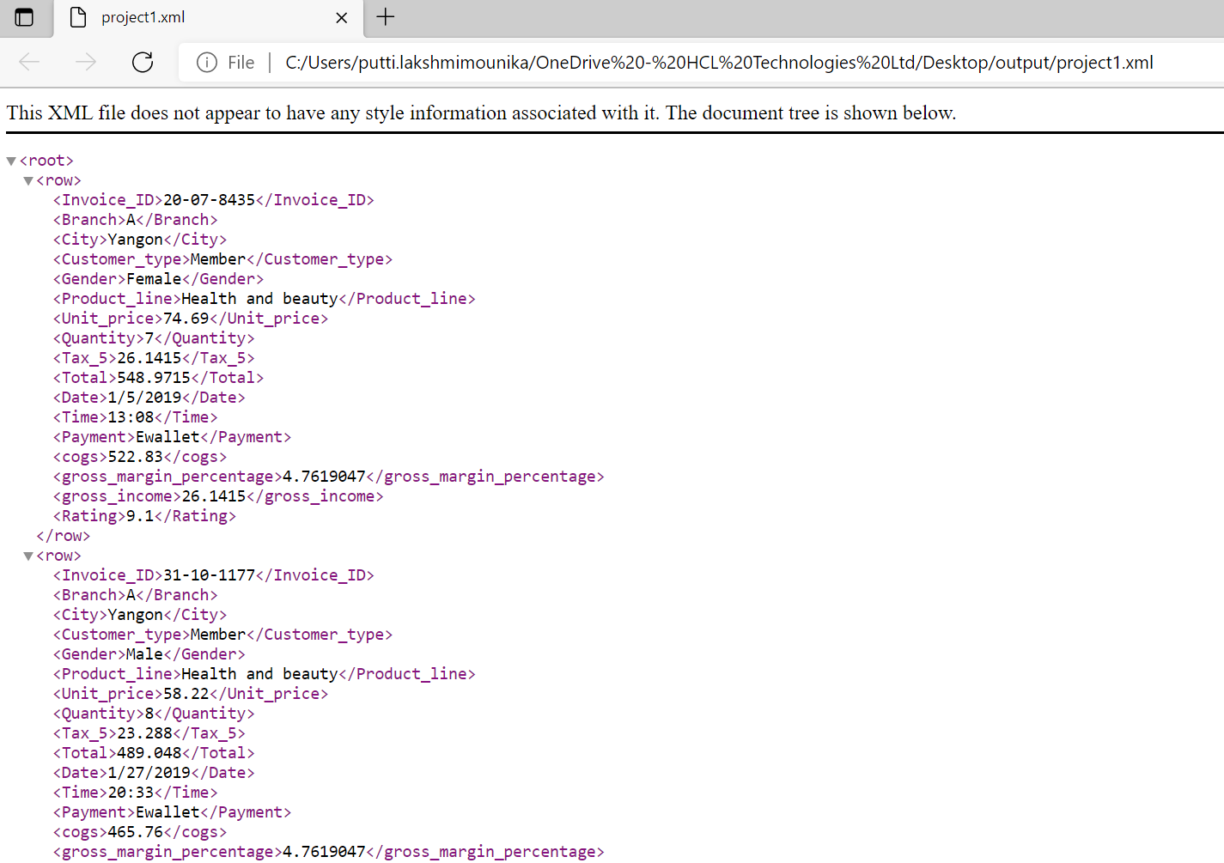
tFileoutput.Xml can be opened in browser to see the output data.

Slide 11
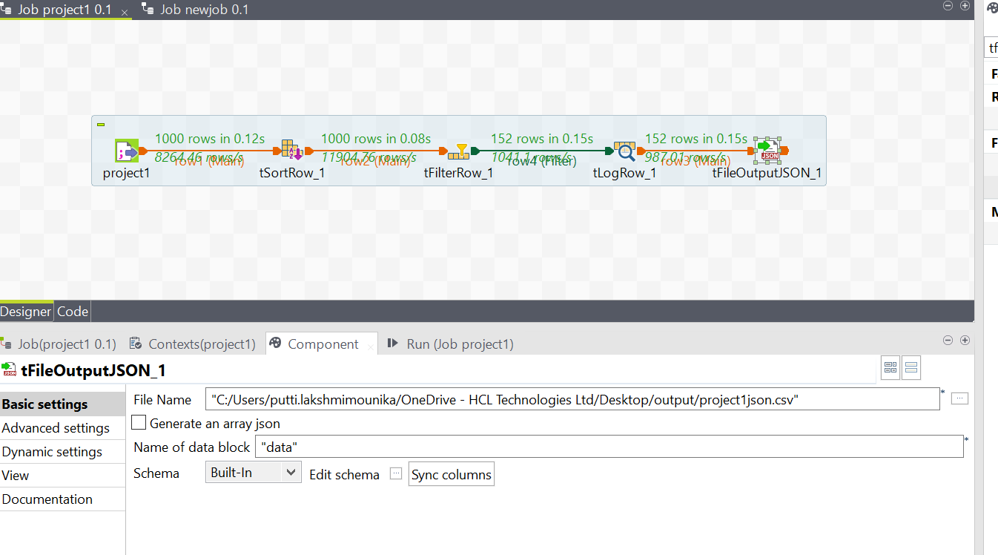
tFileoutputJson is an json format file which gives data in the Json format.

Slide 12
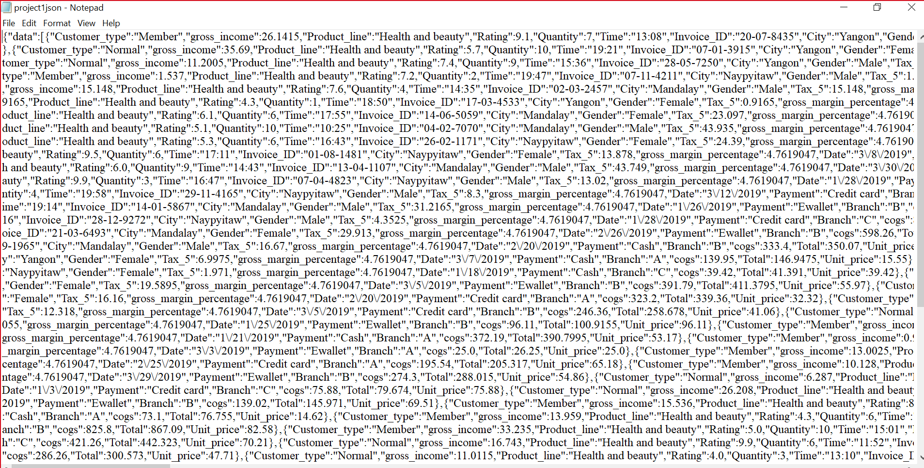
We can open Json output file in notepad format and view the data.

Slide 13
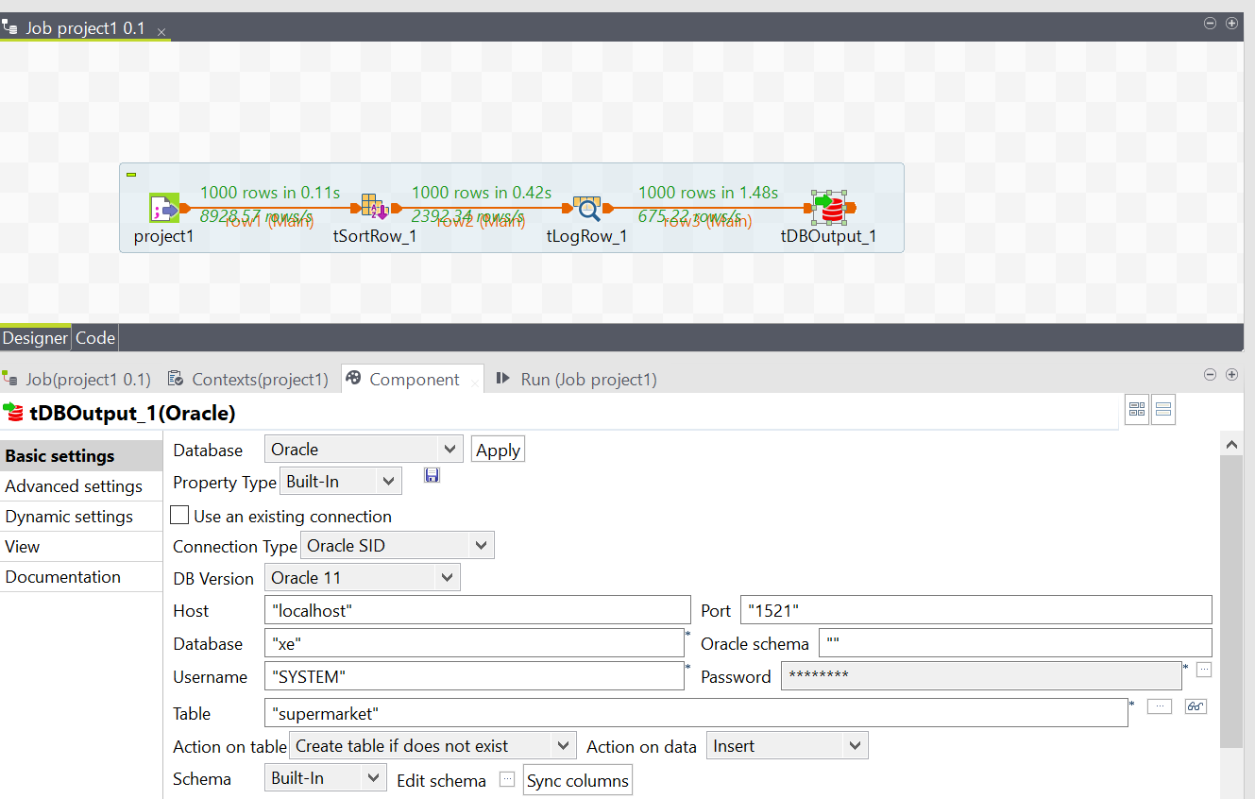
tDBOutput is an database component in which we can apply any database(Oracle SQL).

Slide 14
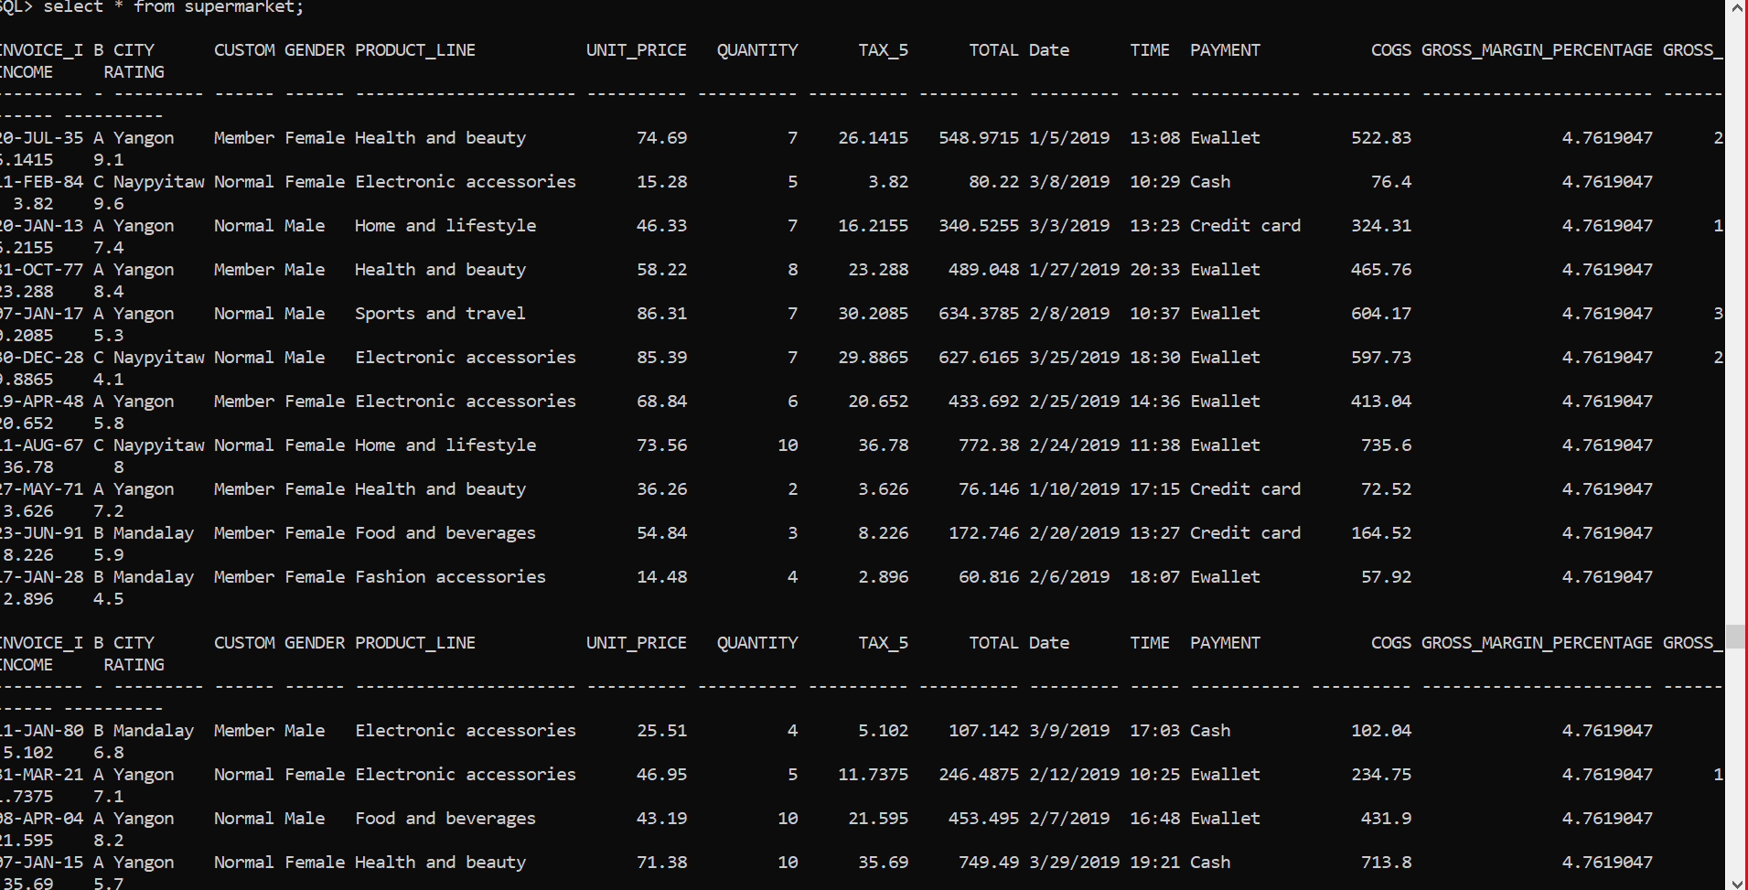
After running job the data will be inserted into the selected database(Oracle SQL).

Slide 15
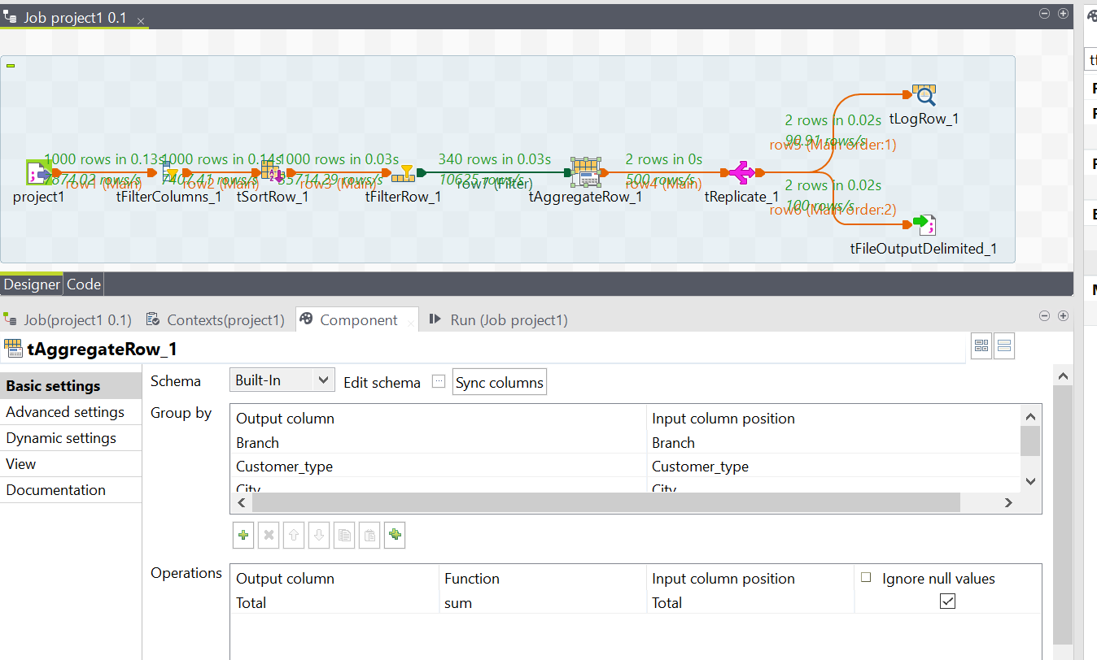
Using tFiltercolumns and tFilterrows we can filter the data.
Using tagrregaterow we can perform mathematical operations on data..

Slide 16
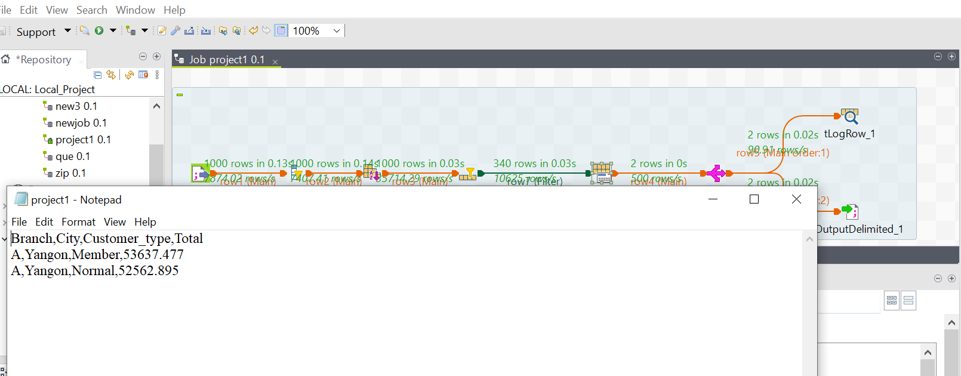
Using treplicate we can pass the source data to multiple target components. tsortrow component is used to sort the data in ascending or descending order. tLogrow allows to write data, that is flowing through Job (rows), to the console.

Slide 17
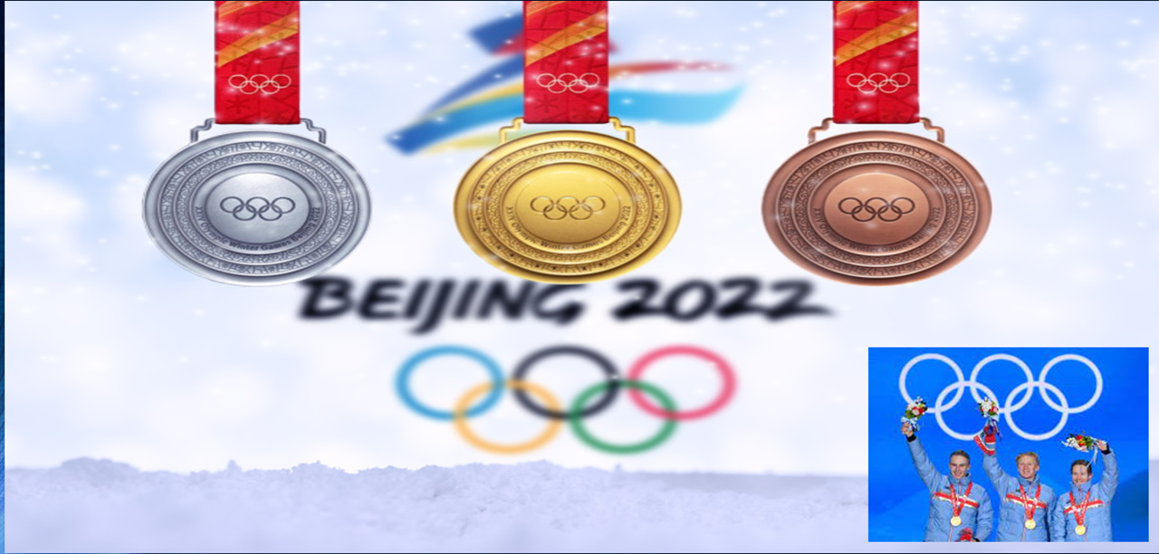
Beijing olympic games 2022

Slide 18
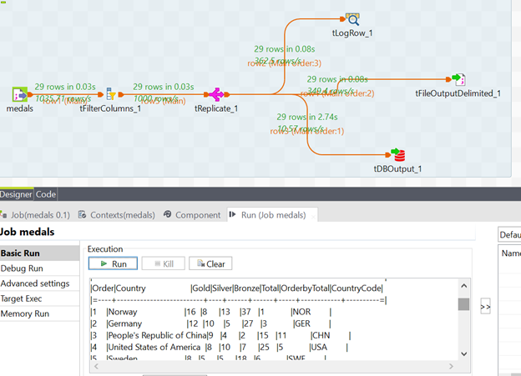
Medals
Viewing the data in Oracle, talend and in tfileoutput delimited.
Using replicate , we connected the input file to three output files.

Slide 19
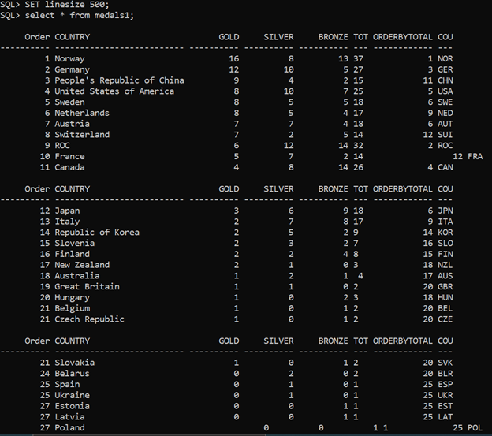
Viewing the output of input file in oracle.

Slide 20
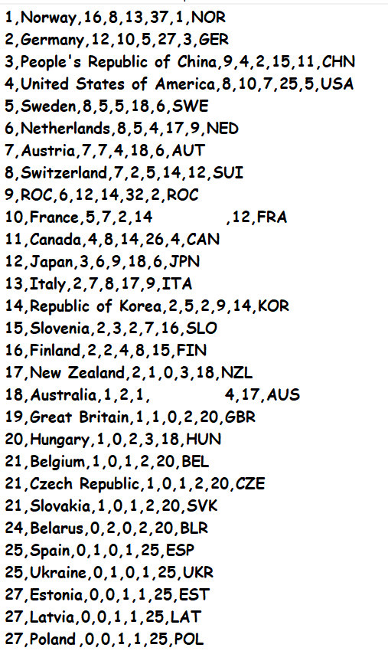
Viewing the output in tfileoutputdelimited

Slide 21
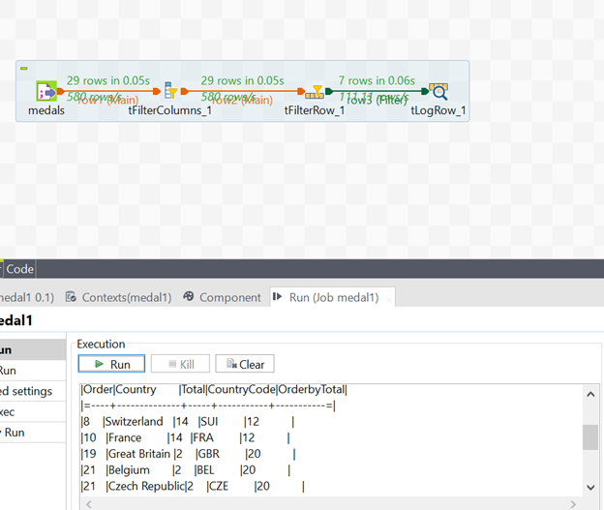
The output data where total of medals = 12 or 20

Slide 22
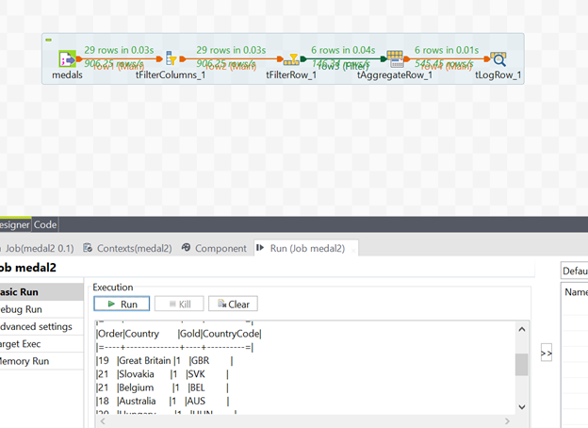
The output in which the countries have 1 gold medal

Slide 23
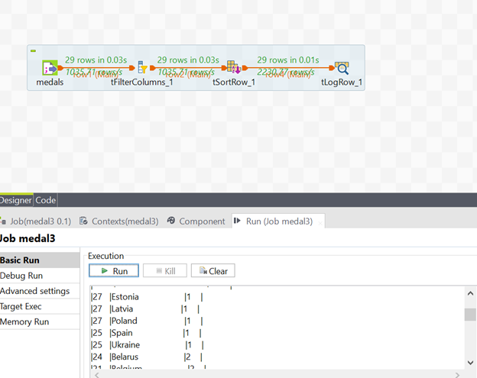
Sorting of data in descending order.

Slide 24
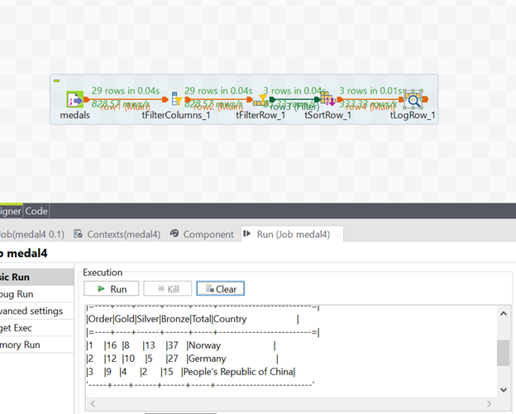
To see the output in which the order is less than or equal to 3

Slide 25
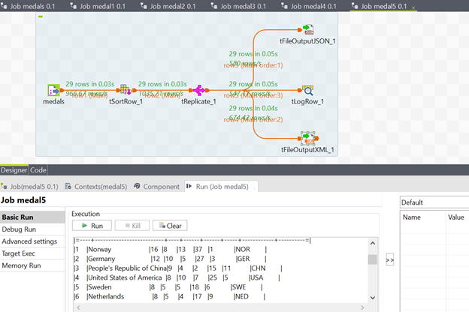
Viewing the output in json and xml files

Slide 26
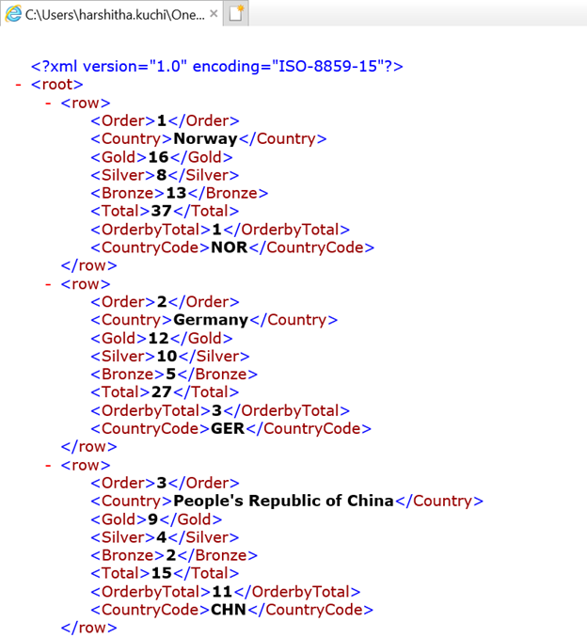
Output in xml file:

Slide 27
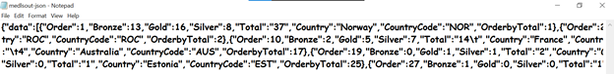
Output in json file:

Slide 28

Putti Lakshmi Mounika
Harshitha Kurchimanchi
Pamarthi Pavani
Kokkari CharanRaj
Kendre Ganesh

